Slide 1
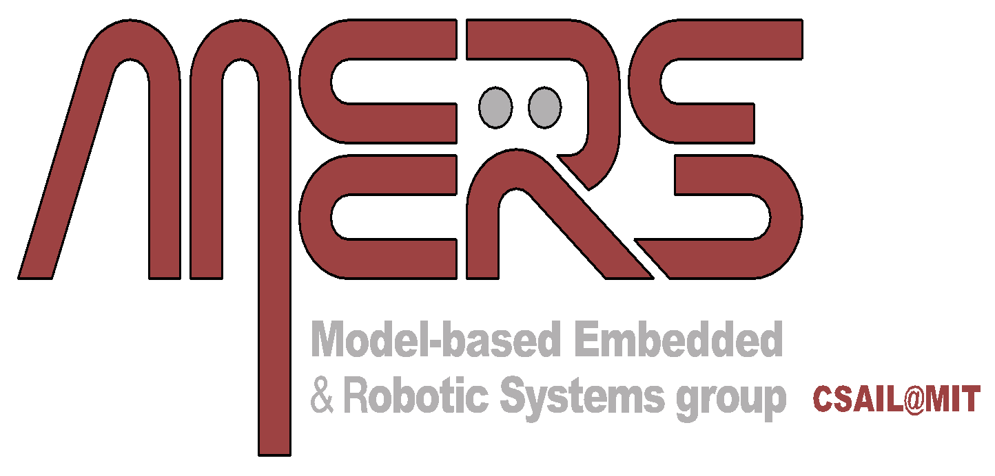
Multi-Agent Vulcan: An Information-Driven Multi-Agent Path Finding Approach
Jake Olkin, Viraj Parimi, Brian Williams
17th October 2024

Slide 2
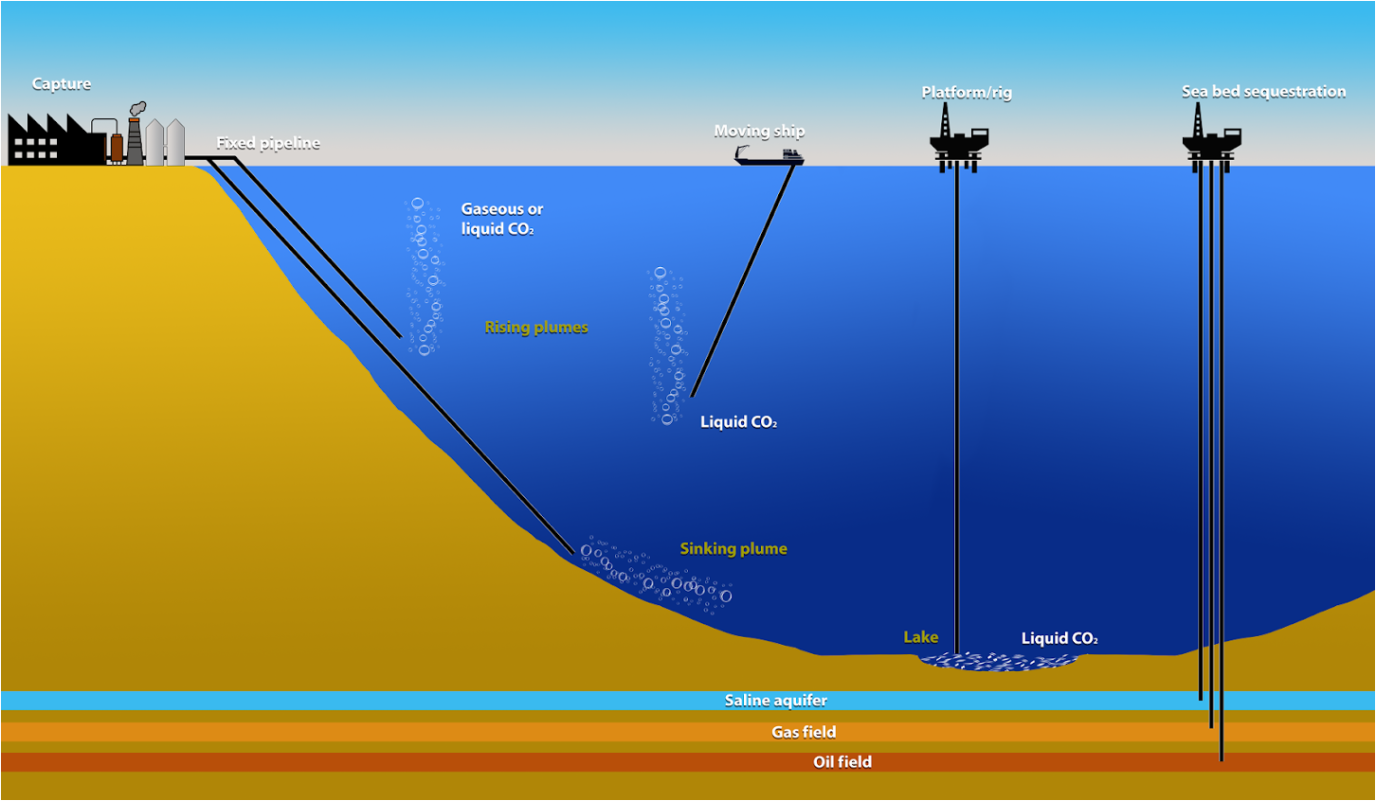
Motivation
Multi-Agent Vulcan
Leaks
Goal: Locate as many potential CO₂ leaks as possible within a fixed mission horizon
Notes:
Oil companies like BP attempt to reduce CO2 emissions by storing CO2 in pools under the ocean floor.
However, if one of these pools were to leak, all of the stored CO2 would release into the atmosphere, so these need to be identified quickly.
To do this, Autonomous Ocean Gliders are deployed to monitor and search for leaks in an environment where they can only communicate when they are close by.
Make it more clear that this is multi-agent and multi-leak

Slide 3
Problem Features
Multi-Agent Vulcan
Multiple agents and phenomenon of interest
Finite mission horizon
Communication within a fixed range
Spatial correlation between observed features and phenomena of interest
Goal: Locate as many potential CO₂ leaks as possible within fixed a mission horizon

Slide 4
Key Insights
Multi-Agent Vulcan
Autonomous vehicles tasked with searching for a phenomenon of interest will be more efficient if they make use of each other’s past and potential future observations.
Agents need to coordinate to minimize redundant observations
Observations inform each other ↔ coupled reward function
A decoupled version of the reward function can act as an admissible heuristic
Multi-Agent Vulcan: An optimal receding-horizon multi-agent path planner under limited communication for exploration
Notes:
We seek to solve this problem by leveraging the past and potential future observations of the agents to increase the efficiency with which we will find a phenomenon of interest, such as a CO2 leak.
Three new bullets:
Coordination is important to reduce redundant observation
Decopled reward function
Maybe on separate slide –
Space is important

Slide 5
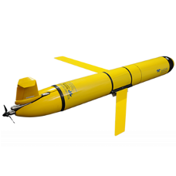
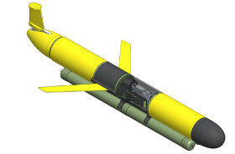
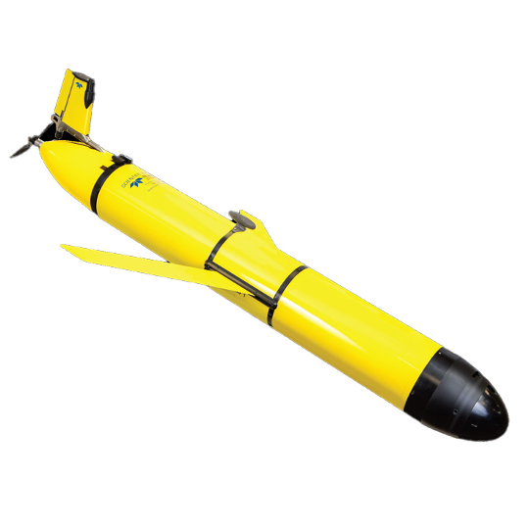
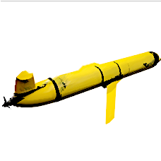
Decoupled Information Heuristic
Multi-Agent Vulcan
Agent A
Agent B
Agent Cluster
Coupled Reward Function
Decoupled Heuristic
Notes:
Computing I over this joint distribution of observation RVs is hard and compute intensive so we should avoid doing this as much as possible.
Duplicate slide to add version with the A* point from Slide 5

Slide 6
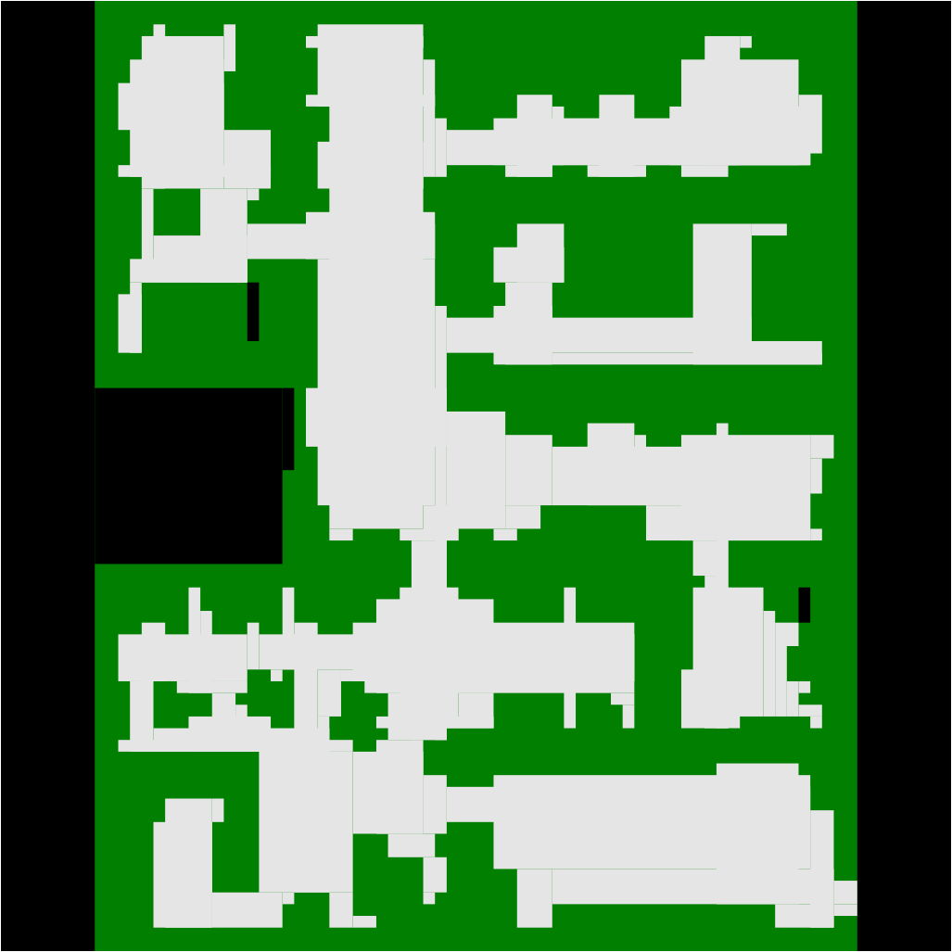
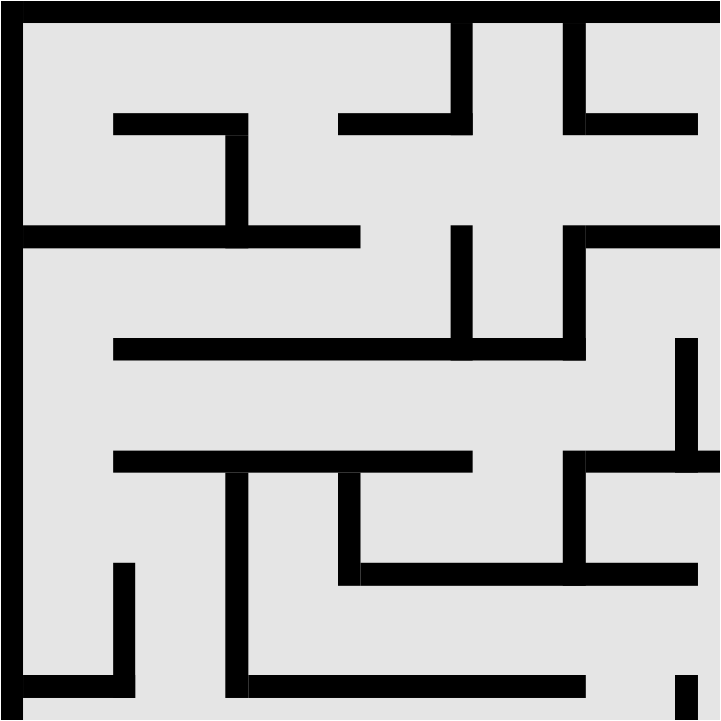
Multi-Agent Path Finding Benchmark Maps
Multi-Agent Vulcan
Dense (65x81)
Maze (32x32)
Notes:
We compare our method against some baselines first on the
dense 65x81,
and the maze 32x32 maps along with some other maps available in the MAPF domain. Each experiment comprised of 100 test runs each, featuring randomly positioned agents and simulated measurement fields containing up to $N$ target phenomena. These tests varied in mission duration and employed a planning horizon of 2.

Slide 7
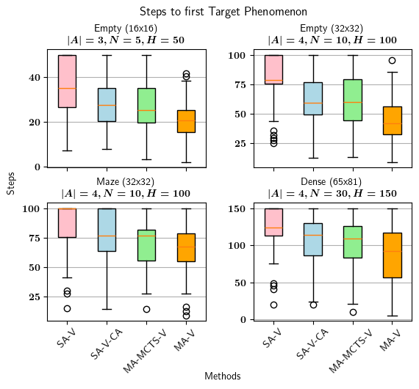
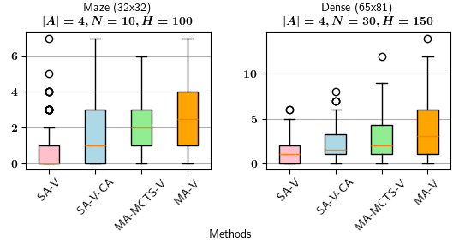
MAPF Benchmark Experiments
Multi-Agent Vulcan
Steps to first Target Phenomenon
(Lower is better)
Number of Unique Phenomenons Discovered
(Higher is better)
Orange bar is Multi-Agent Vulcan!
Notes:
Here we demonstrate that agents utilizing our approach encounter their first unique phenomenon of interest
sooner compared to the alternative methods indicating that the agents are able to avoid the redundant observations problem (Lower is better)
Second, our proposed approach successfully discovers more phenomena of interest within the same mission duration while avoiding collisions with other agents. (Higher is better)

Slide 8
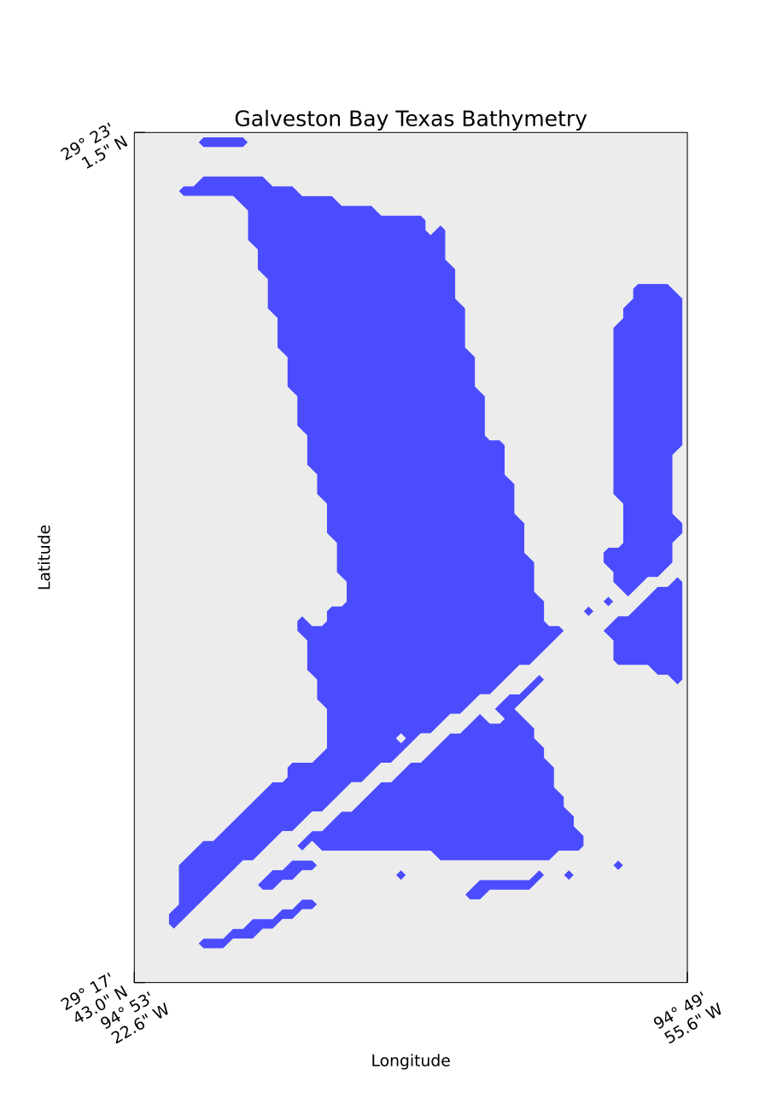
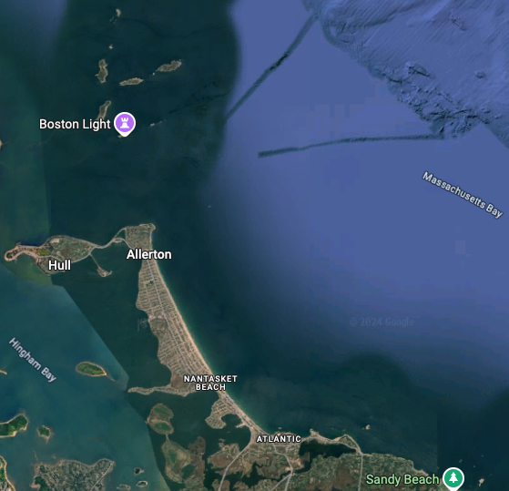
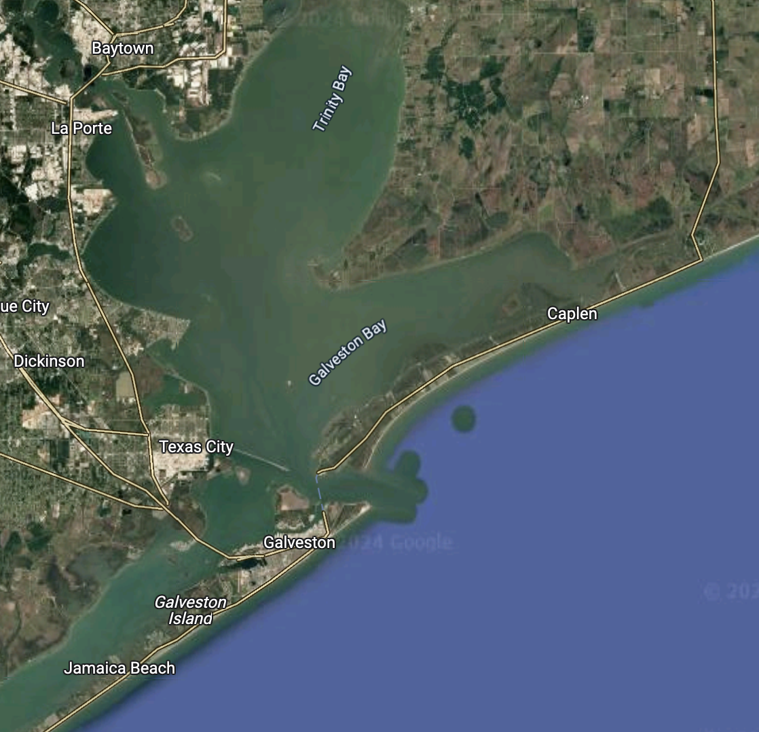
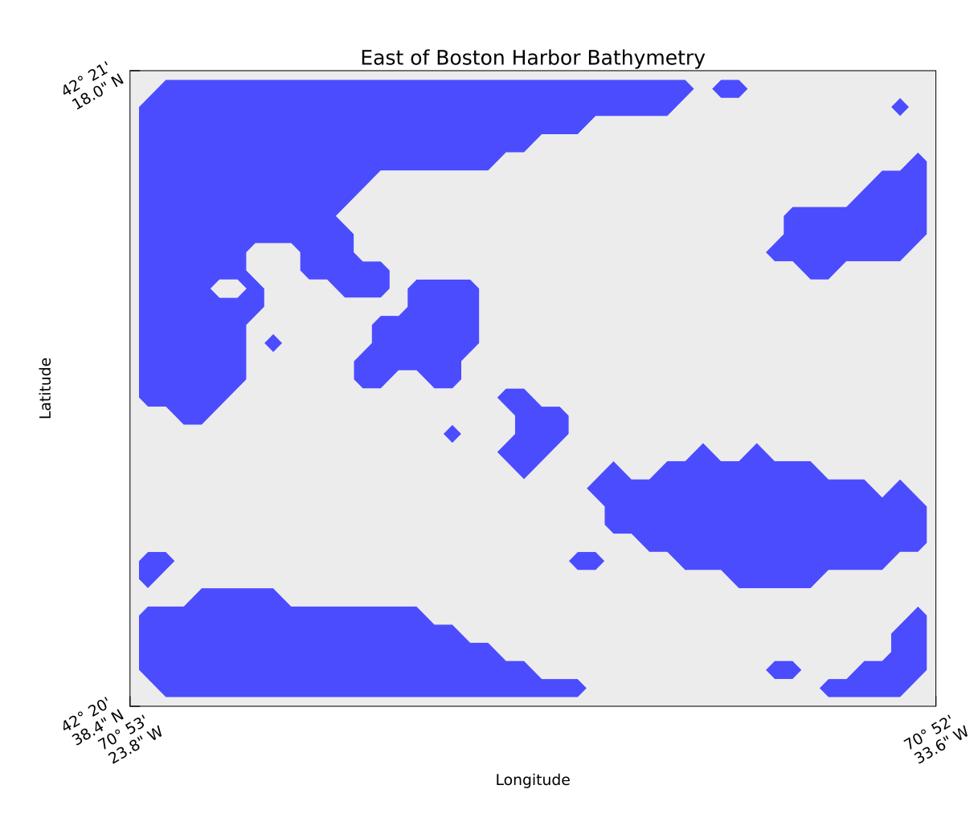
Real World Bathymetric Datasets
Multi-Agent Vulcan
Boston Harbor
Galveston Bay
Notes:
In addition, we also benchmarked our algorithm on real-bathymetric datasets.
First we use the beautiful east-boston harbor area where we simulated the AUV navigating at a consistent depth of 15 meters,
using 15-meter depth contours as obstacles resulting in the following obstacle map.
Second, we used Galveston Bay as our next location,
where 2-meter depth contours determined obstacle boundaries for the AUV.

Slide 9
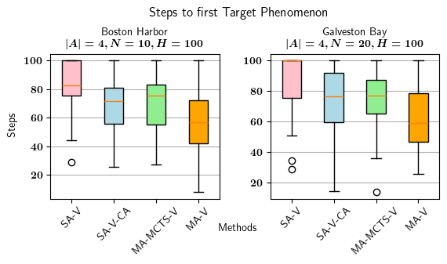
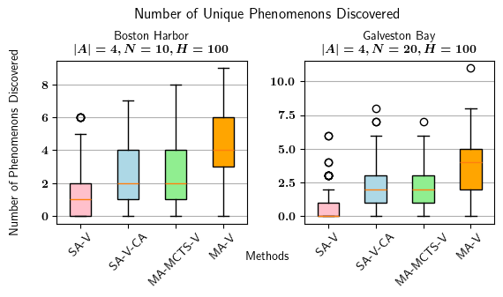
Real World Bathymetric Datasets
Multi-Agent Vulcan
Boston Harbor
Galveston Bay
Notes:
Here, similar to our MAPF benchmarks, our experiments demonstrated that agents utilizing our approach are able to encounter their first unique phenomenon of interest sooner (Lower is better)
Second, our proposed approach successfully discovers more phenomena of interest within the same mission duration. (Higher is better)

Slide 10
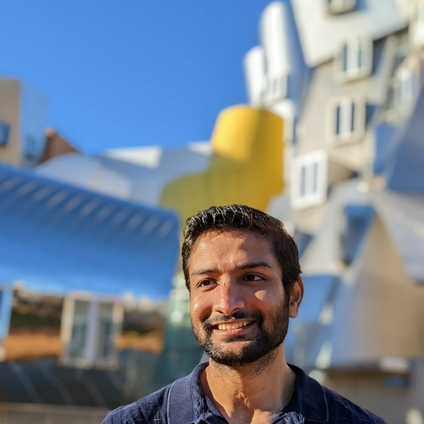
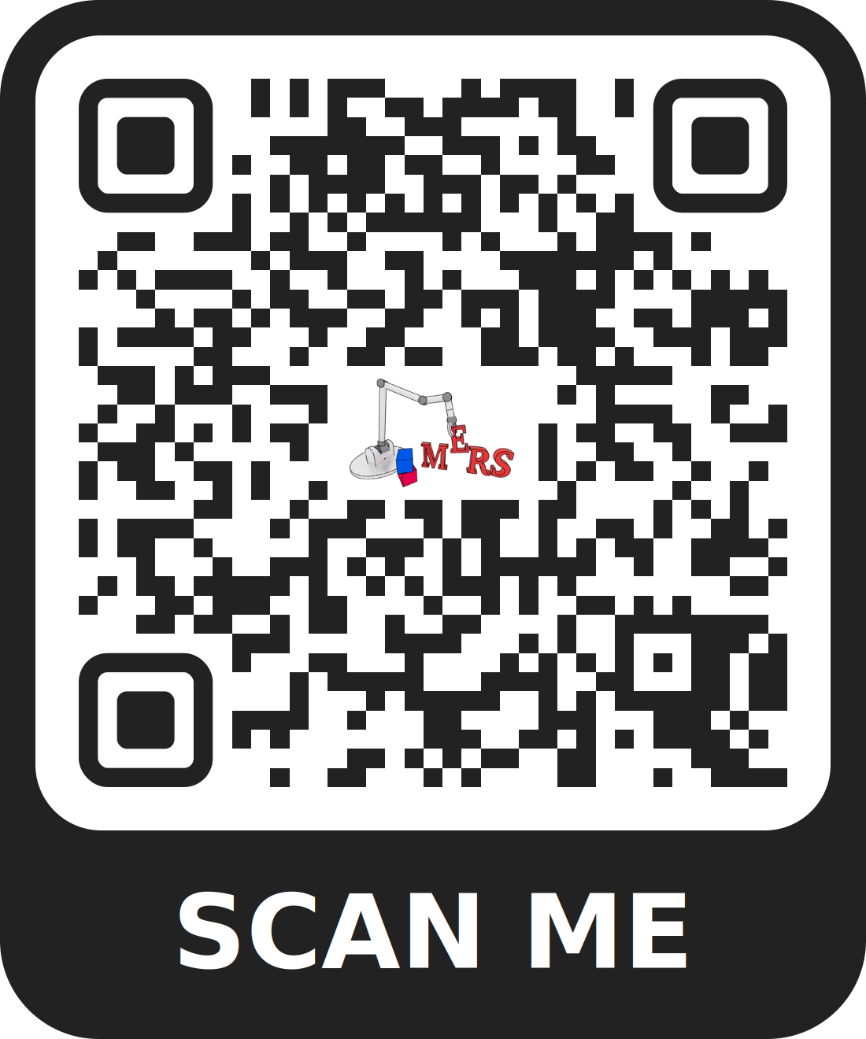
Multi-Agent Vulcan: An Information-Driven Multi-Agent Path Finding Approach
Jake Olkin, Viraj Parimi, Brian Williams
Notes:
Thank you so much for listening! Please scan the QR code to access more details about our paper and approach including videos of real-hardware experiments and reach out to us for any questions!

